Slide 1
JAVA OOPS CONCEPT

Slide 2
Procedural Programming:
Procedural Programming can be defined as a programming model which is derived from structured programming, based upon the concept of calling procedure.
There is no access specifier in procedural programming i.e Visibility mode.
Adding new data and function is not easy.
Procedural programming does not have any proper way for hiding data so it is less secure.
Examples: C, FORTRAN, Pascal, Basic etc.

Slide 3
Object Oriented Programming:
Object oriented programming can be defined as a programming model which is based upon the concept of objects. Objects contain data in the form of attributes(variables) and code in the form of methods(functions).
Object oriented programming have access specifiers like private, public, protected etc.
Adding new data and function is easy.
Object oriented programming provides data hiding so it is more secure.
Examples: C++, Java, Python, C# etc.

Slide 4
Why Java ?
Portable
Independent
Secure

Slide 5
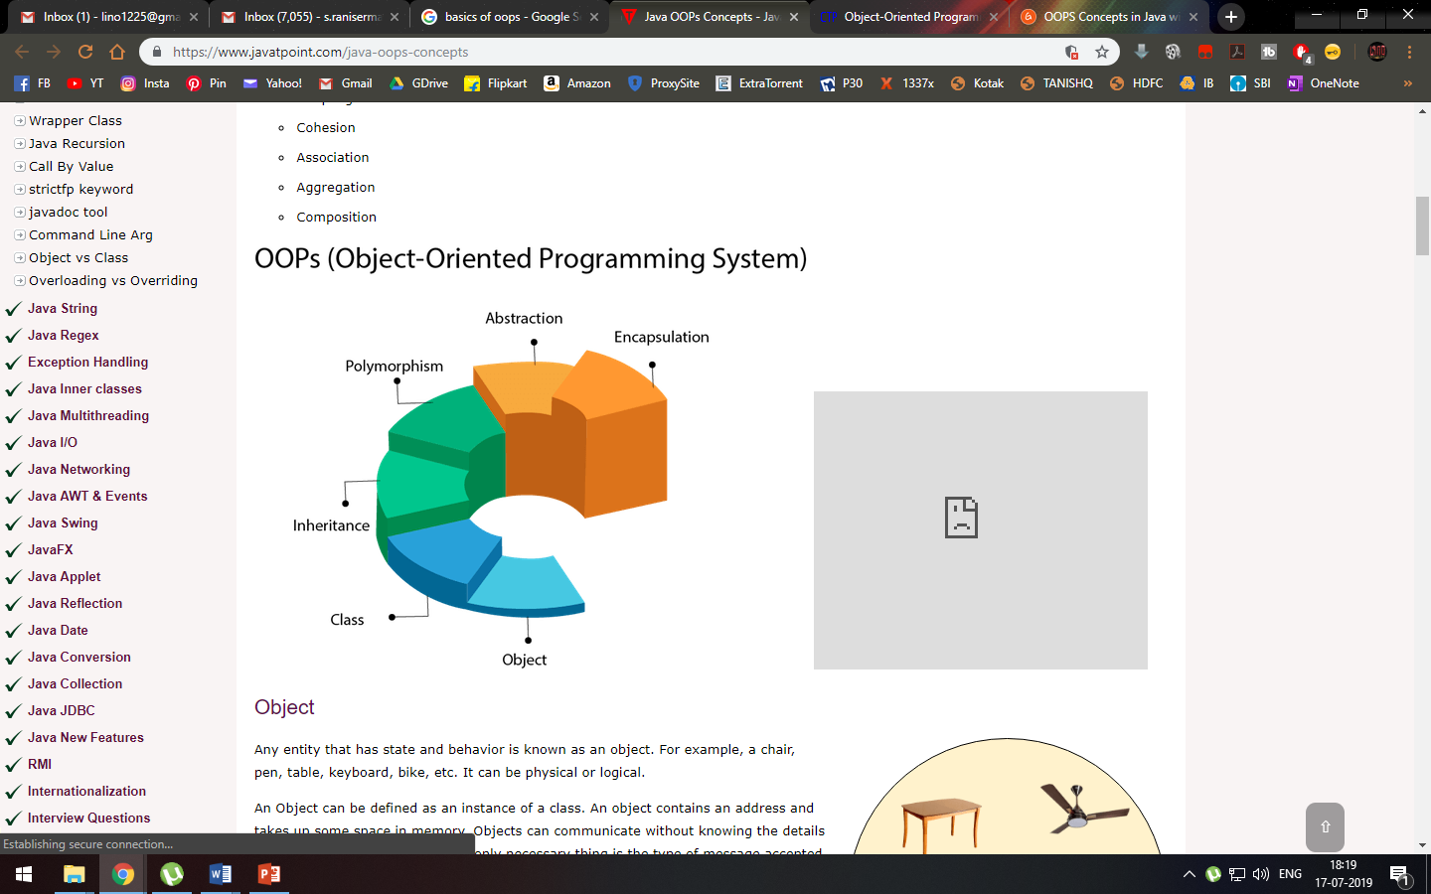

Slide 6
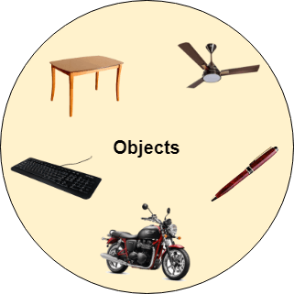
1. Object
Any entity that has state and behavior is known as an object.
An Object can be defined as an instance(event or element) of a class.
Example: A dog is an object because it has states like color, name, breed, etc. as well as behaviors like wagging the tail, barking, eating, etc.

Slide 7
2. Class
The class is a group of similar entities.
A class can also be defined as a blueprint from which you can create an individual object.
3. Inheritance
When one object acquires all the properties and behaviors of a parent object, it is known as inheritance.
It provides code reusability.
4. Polymorphism
If one task is performed in different ways, it is known as polymorphism. For example: to convince the customer differently, to draw something, for example, shape, triangle, rectangle, etc.

Slide 8
5. Abstraction
Hiding internal details and showing functionality is known as abstraction. For example phone call, we don't know the internal processing.
6. Encapsulation
Binding (or wrapping or hiding) code and data together into a single unit are known as encapsulation.

Slide 9
Platform Dependent
gcc
myprog.exe
myprog.c
machine code
C source code
OS/Hardware
Platform Independent
javac
myprog.class
myprog.java
bytecode
Java source code
JVM
OS/Hardware

Slide 10
JVM
JVM stands for Java Virtual Machine

Slide 11
Basics of Java: 1. Variables or Data Members of class: Used to store data or values. 2. Datatypes: Depending on data or values datatypes where given E.g. For integer data or values datatype int is used

Slide 12
Primitive types
int 4 bytes
short 2 bytes
long 8 bytes
byte 1 byte
float 4 bytes
double 8 bytes
char Unicode encoding (2 bytes)
boolean {true,false}
Behaviors is exactly as in C++
Note:
Primitive type
always begin
with lower-case

Slide 13
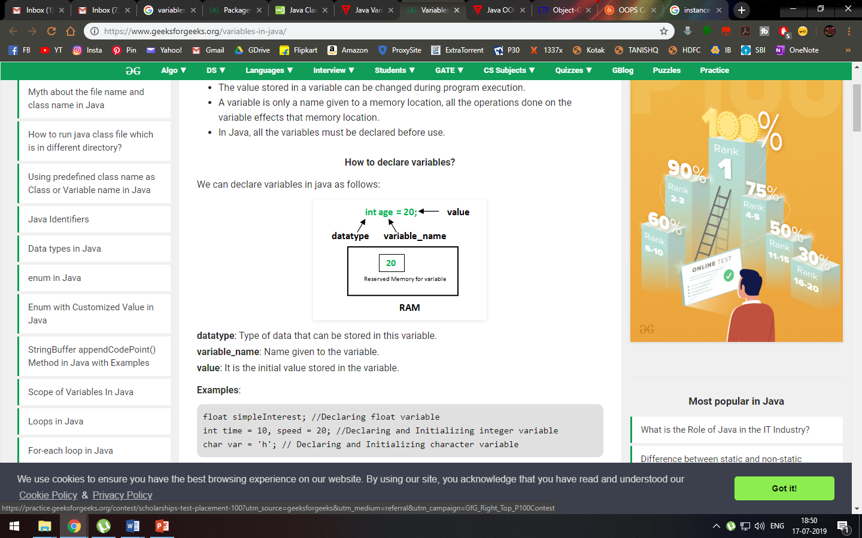

Slide 14
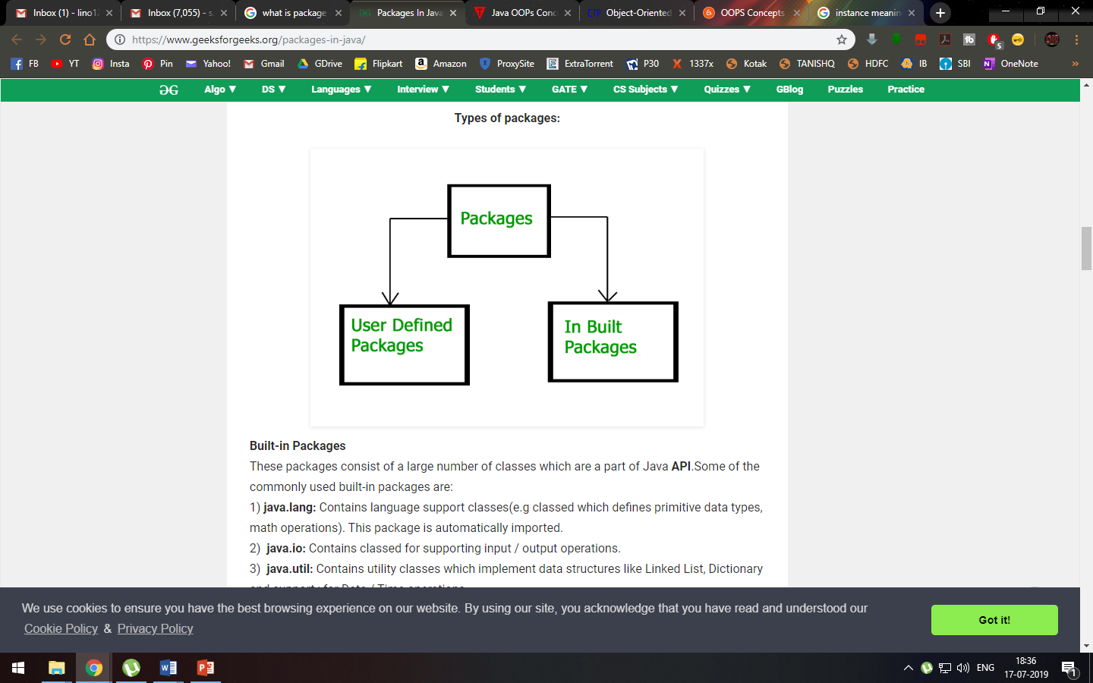
Packages In Java
Package in Java is a mechanism to encapsulate a group of classes, sub packages and interfaces.
Example :
// import all the classes from util package
import java.util.*;

Slide 15
In-Built Packages 1. java.io: Contains classed for supporting input / output operations. 2. java.util: Contains utility classes which implement data structures like Linked List, Dictionary and support ; for Date / Time operations or Scanner class.

Slide 16
Java Classes/Objects
Everything in Java is associated with classes and objects, along with its attributes and methods. For example: in real life, a car is an object. The car has attributes, such as weight and color, and methods, such as drive and brake.
Create a Class or Define a Class
To create a class, use the keyword class:
MyClass.java (Save file named as .java)
//Create a class called "MyClass"
Syntax:
public class MyClass
{
}

Slide 17
Access Control
public member (function/data)
Can be called/modified/ instantiated from outside.
protected
Can be called/modified from derived classes
private
Can be called/modified only from the current class
default ( if no access modifier stated )
Can be called/modified/instantiated from the same package.

Slide 18
Hello World
Hello.java
import java.io.*;
class Hello {
public static void main(String[] args) {
System.out.println(“Hello World !!!”); }
}
C:\javac Hello.java
C:\java Hello
( compilation creates Hello.class )
(Execution on the local JVM)

Slide 19
Compiling/running first java program
Create source code file (call it for example MyFirstProgram.java).
To compile:
prompt >> javac MyFirstProgram.java
This produces byte code file named
MyFirstProgram.class
To run:
prompt >> java MyFirstProgram

Slide 20
Java Methods
A method is a block of code that performs a specific task.
Suppose you need to create a program to create a circle and color it. You can create two methods to solve this problem:
a method to draw the circle
a method to color the circle
In Java, there are two types of methods:
User-defined Methods: We can create our own method based on our requirements.
Standard Library Methods: These are built-in methods in Java that are available to use.

Slide 21
Declaring a Java Method
The syntax to declare a method is:
Access_specifier returnType methodName() {
// method body
}

Slide 22
Example 1: Java Methods
class Main {
// create a method
public int addNumbers(int a, int b) {
int sum = a + b;
// return value
return sum;
}
public static void main(String[] args) {
int num1 = 25;
int num2 = 15;
// create an object of Main
Main obj = new Main();
// calling method
int result = obj.addNumbers(num1, num2);
System.out.println("Sum is: " + result);
}
}

Slide 23
Programs
Write program to find area of a square by creating without function
Write program to find area of a square by creating function

Slide 24
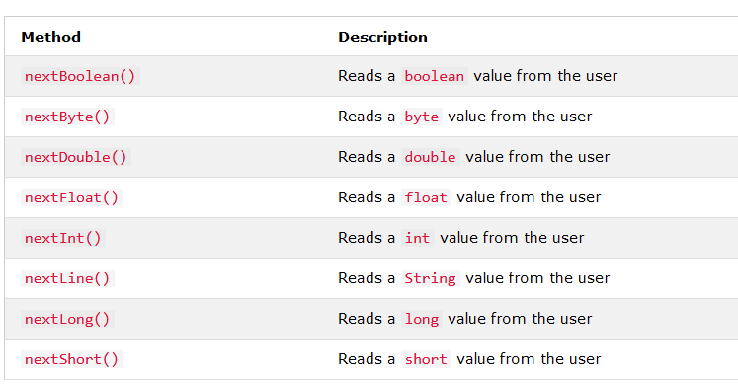
Java User Input(Scanner Class)
The Scanner class is used to get user input, and it is found in the java.util package.
To use the Scanner class, create an object of the class and use any of the available methods found in the Scanner class documentation.

Slide 25
Example
import java.util.Scanner; // Import the Scanner class
class Main {
public static void main(String[] args) {
Scanner myObj = new Scanner(System.in); // Create a Scanner object
System.out.println("Enter username");
String userName = myObj.nextLine(); // Read user input
Float f=myObj.nextFloat();
System.out.println("Username is: " + userName); // Output user input
}
}

Slide 26
THANK YOU

